Slide 1


Slide 2
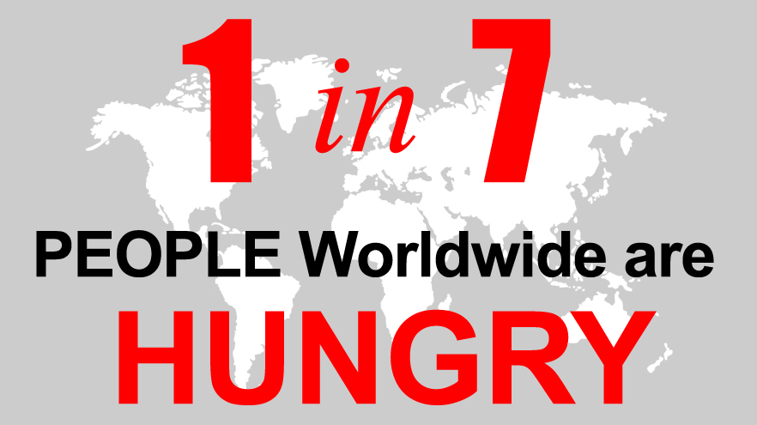

Slide 3
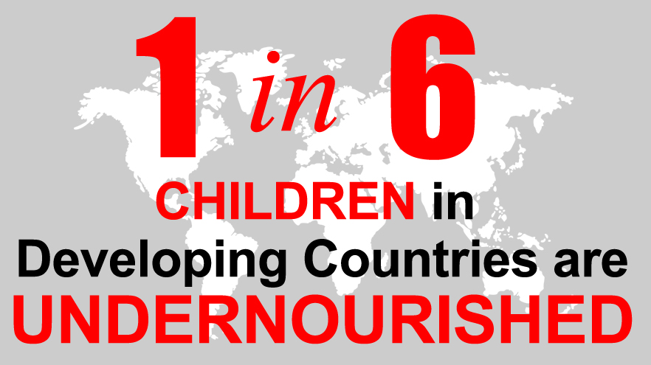

Slide 4
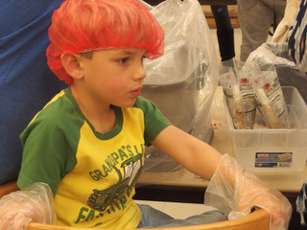
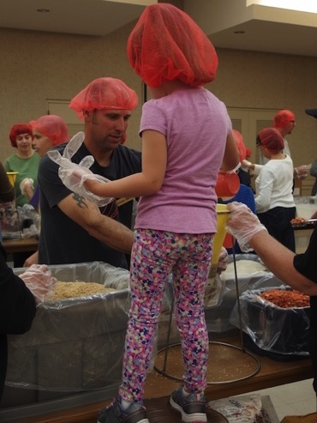
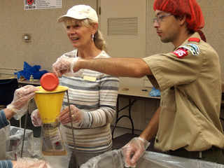
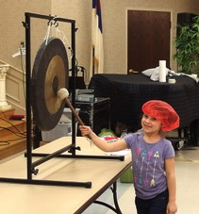
We Can Help!

Slide 5

And
so can YOU!

Slide 7
What is a
Meal Packing Event,
and how does it help
solve worldwide hunger?

Slide 8

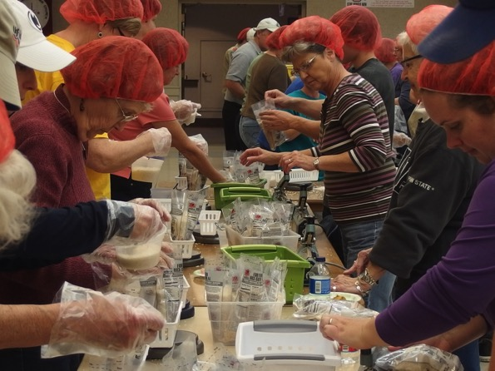
Working with our partner, we provide the people-power to package critical ingredients into nutritious meals that Rise Against Hunger will distribute to hungry children in schools, orphanages,
and families suffering from natural disasters.

Slide 9


Slide 10
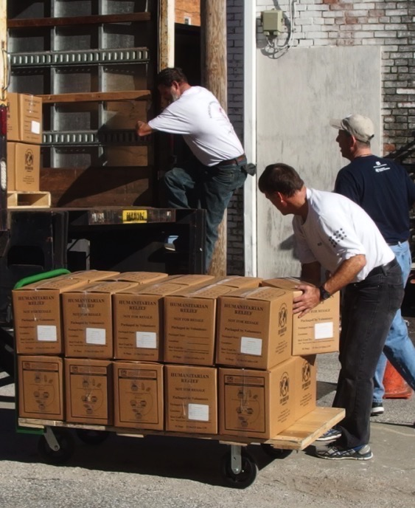
Hanoverians have been doing this
since 2012!
2012: 40,188 meals
2014 31,884 meals
2016 43,416 meals
Totals since 2012:
115,488 meals packed
$28,819 raised
500+ Volunteers Involved

Slide 11
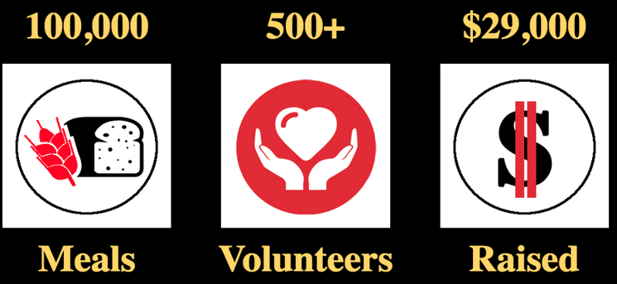
In 2018, we are aiming HIGHER!
$
Working together, we can do this!

Slide 12
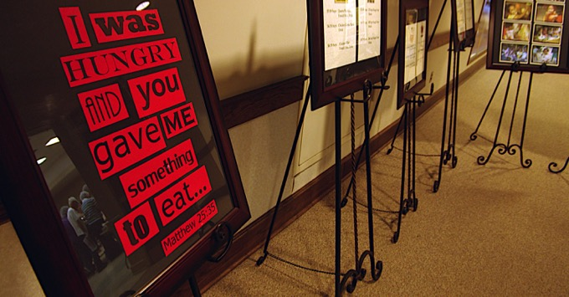
Register to Help Pack Meals
There are easy tasks for all ages, all capabilities. PLUS, it’s FUN!

Slide 13
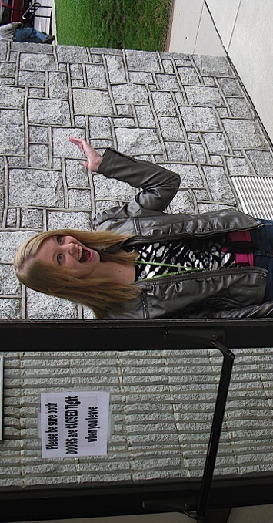
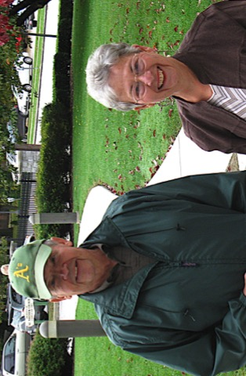
Donate to the Event!
Every 29¢ covers one meal.
Our goal is 100,000 meals; $29,000.

Slide 14
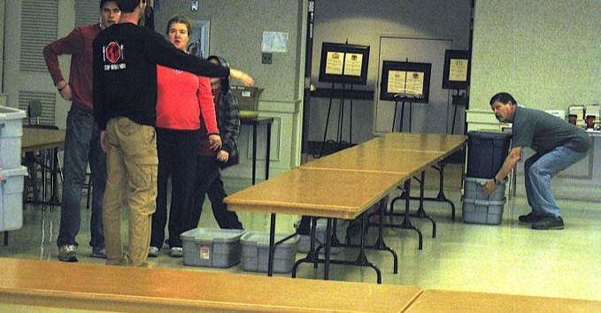
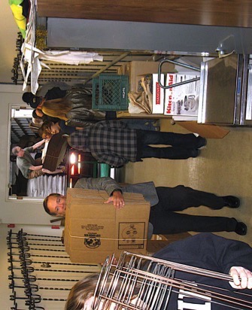
Spread the Word.
Tell everyone you know about the project. The more people who know, the more people involved.

Slide 15
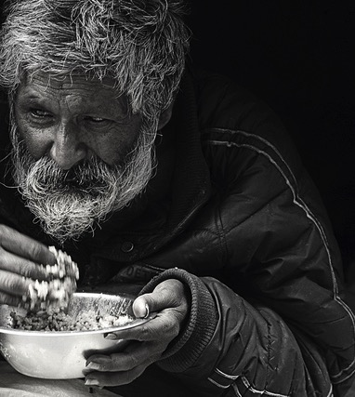
“A hungry man
can’t see right or wrong.
He just sees food.”
– Pearl S. Buck

Slide 16
Be a part of it all!

Slide 17
To learn more or stay in touch:
On line:
www.stmattlutheran.org/meal-packing
eMail:
meal-packing@stmattlutheran.org
On Facebook:
Bi-Annual Hanover Area Community
Meal Packing Event
On Twitter: Hvr Cmty Meal Packing
On line:
Visit: events.stophungernow.org/SMLC18
To Register or to Donate

